Slide 1
3.1 Scatterplots and Correlations

Slide 2
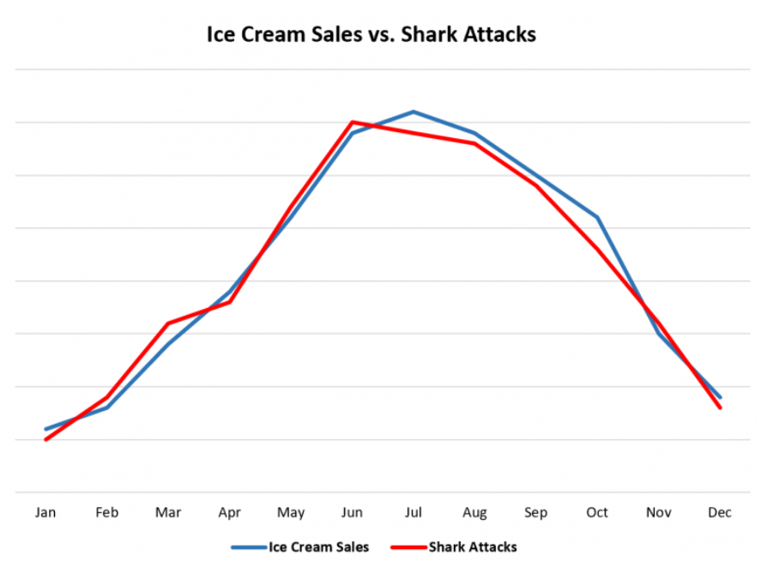
Bi-Variable Correlation:
In this chapter we will look at establishing correlation between TWO Quantitative variables
When One variable increases, does the other variable also increase/decrease
Is there a Correlation between two variables? How strong is this connection?
Key Idea: Correlation DOES NOT imply Causation!!
Ex: Ice-cream sales and shark attacks:
In the US, the number of ice cream sold per month is highly correlated with the number of shark attacks
Does this mean that consuming more icecream increases shark attacks???
NO!! When the weather gets warmer, both ice cream consumption and ppl on beach increases. More people on beaches leads to more shark attacks.

Slide 3
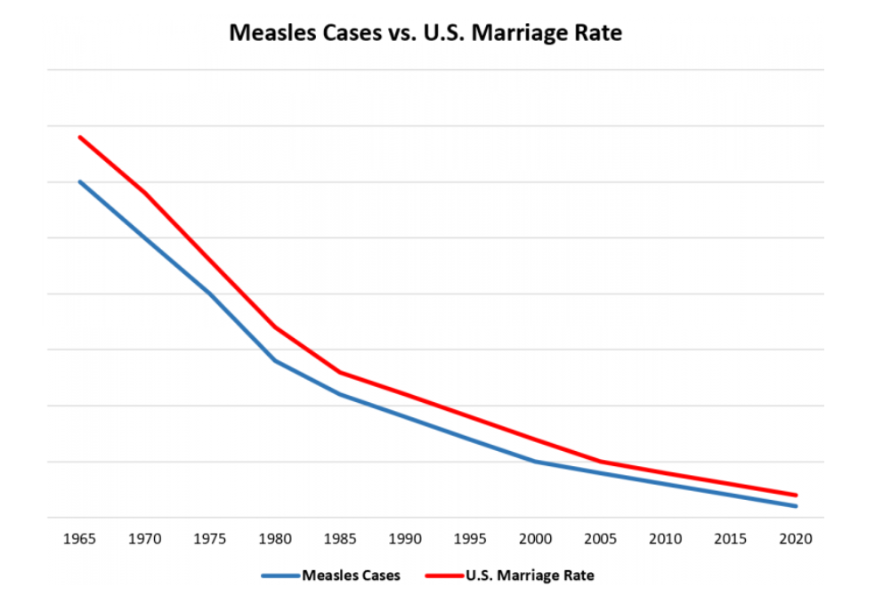
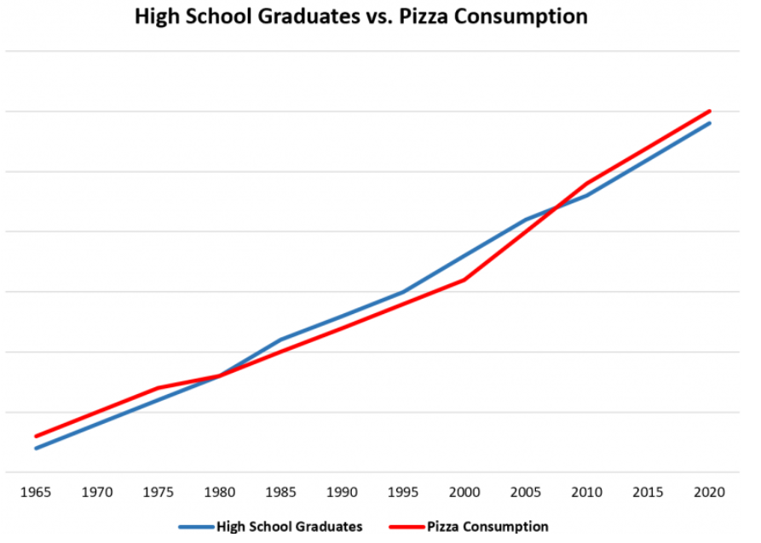
Correlation Does NOT imply Causation:
Measles Cases and Marriage Rate:
Data shows that a decline in measle cases is highly correlated in the decline in marriage rates in the US
Does this mean that reducing measle cases is lowering marriage rates?
NO! These two variables are independent!! Progress modern medicine is reducing measle cases. With progress, many people are becoming independent choosing not to marry.
High School Graduates vs Pizza Consumption:
Another strong correlation b/n more people graduating from HS and more pizzas consumed in US. IS there a causation???
Both are increasing simply because of an increase in population!

Slide 4
What is Causation? How is it DEFINED?
How do you prove that variable “A” CAUSES variable “B”?
CASES 1: Variable “A” Exists
Variable “B” ALSO Exists
CASES 2: (Control Group) Variable “A” DOES NOT Exist
Variable “B” DOES NOT Exists
Every OTHER variable is consistent between the two cases. The ONLY difference is that variable “A” exists in case 1 but not case 2

Slide 5
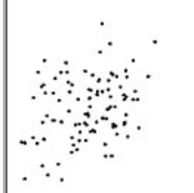
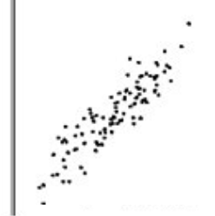
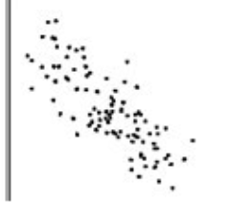
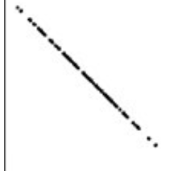
Describing a Scatter Plot:
Direction: Positive Correlation
Direction: Positive
Shape: Non-linear
Points are scattered everywhere
Shape:
Somewhat linear
Ice Cream Sales
Salary (1000s)
Large cluster in the middle
Strength: Weak to No correlation
Strength: Strong Correlation
Temp (Celsius)
Outliers? None
Years Employed
Negative Correlation
Very Strong Negative Correlation
Distance (km)
Somewhat linear
Gas left in tank (L)
Scatterplot forms a very clear linear relationship
Moderate to Weak correlation
Age (years)
Distance Travelled

Slide 6
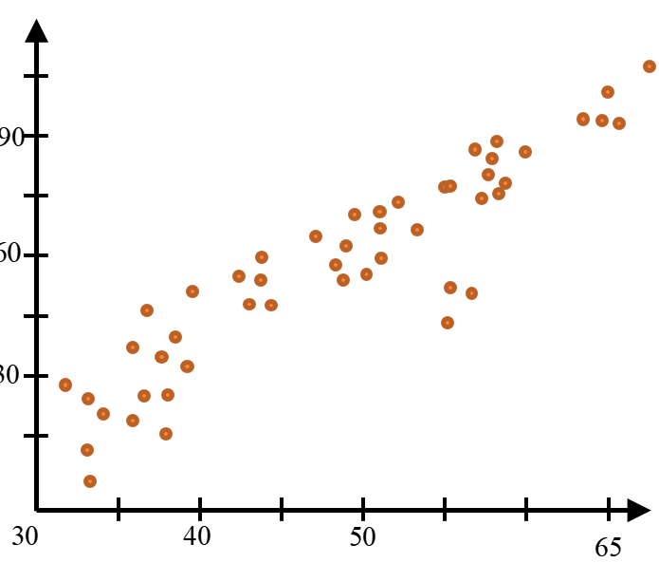
Scatterplots and Correlation (r)
Scatterplots have two variables
Objective: Discover any correlation between the two variables
Correlation: An “association” between two variables, how do changes in one variable affect change in the other?
One of the first things in making a scatter plot is to decide which variable is the Response and which is the explanatory
Response Variable (Y axis)
Final Grade (%)
Make sure you label your Y-axis and have units
The increments don’t have to begin at zero. Adjust your window to get a better graph
Exam Score (pts)
Explanatory Variable
(X-axis)

Slide 7
Explanatory (x) vs Response (y) Variables
The explanatory variable (x) is used to ‘explain’ the variations of the response variable (y)
Explanatory Variable “x” affects Response Variable “y”
There may not always be a clear indicator of which variable is the explanatory or response variable, so read the question carefully
When asked to define each variable, remember to be “PRECISE”
(x) Explanatory variable (Independent)
Variable used to explain the observed outcomes
Age, time, number of people, etc
(y) Response variable (Dependent)
Measures the outcome of a study
Cost, number of sales, salary

Slide 8
IDENTIFY the Explanatory & Response Variables
Ex: The effects of sodium retention in your body from the consumption of carbohydrates were studied in adults aged 30 to 50. Random samples were split into 3 groups that consumed daily amounts of at most 1%, between 1% to 3%, or atleast 3% of their body weights. Subject’s sodium level were measured against their body weights.
Ex: 15 Ice-cream shops were studied to examine the average hourly ice-cream cones they sold in a period of 3 random days in the summer. The temperatures through out each day were recorded to see if it affected ice-cream sales
Ex: Does listening to music affect the your comprehension while studying? A study of 3000 students that listened to either i) classical ii) rap iii) contemporary pop iv) study music while studying during exam season were asked how much of the content they understood based on a scale of 1 to 10.
Researchers at Georgia State Univ. concluded that drivers exiting parking spaces did so more slowly when a driver in another car was waiting for the space than when no one was waiting. [JASP 1997]

Slide 9
Ex: The effects of sodium retention in your body from the consumption of carbohydrates were studied in adults aged 30 to 50. Random samples were split into 3 groups that consumed daily amounts of at most 1%, between 1% to 3%, or atleast 3% of their body weights. Subject’s sodium level were measured against their body weights.
Explanatory variable: the amount of carbohydrate intake as a percentage of your body weight
Response variable: sodium retention as a percentage of your bodyweight

Slide 10
Ex: The effects of sodium retention in your body from the consumption of carbohydrates were studied in adults aged 30 to 50. Random samples were split into 3 groups that consumed daily amounts of at most 1%, between 1% to 3%, or atleast 3% of their body weights. Subject’s sodium level were measured against their body weights.
Explanatory Variable
Response Variable
The daily amount of Carbohydrate consumptions as percentage of body weight. Subjects were grouped into daily consumption groups of “atmost 1%”, “between 1 to 3%”, or “atleast 3%” of their body weights
The amount of sodium as a percentage of their body weight
Ex: 15 Ice-cream shops were studied to examine the average hourly ice-cream cones they sold in a period of 3 random days in the summer. The temperatures through out each day were recorded to see if it affected ice-cream sales
Explanatory Variable
Response Variable
The hourly temperature throughout the day
The average hourly ice-cream cones sold

Slide 11
Ex: Does listening to music affect the your comprehension while studying? A study of 3000 students that listened to either i) classical ii) rap iii) contemporary pop iv) study music while studying during exam season were asked how much of the content they understood based on a scale of 1 to 10.
Explanatory Variable
Response Variable
The type of music genre that students listen to while studying
Students’ response on their comprehension levels on a scale of 1 to 10
Researchers at Georgia State Univ. concluded that drivers exiting parking spaces did so more slowly when a driver in another car was waiting for the space than when no one was waiting. [JASP 1997]
Explanatory Variable
Response Variable
The presence of another car waiting for your parking spot
The amount of time it takes the driver to exit their parking spot

Slide 12
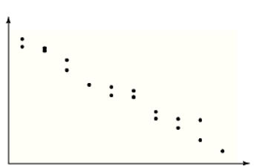
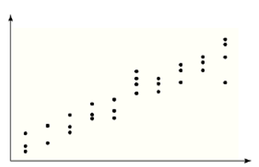
How to Describe Scatterplots
Direction [slope]
Form [Type of relationship]
Linear (Straight Line)
Curved (Exponential, Logarithmic, Root)
Cluster
Strength of the Correlation (r – value) “Scattered” vs “Conformed”
Turn diagnostic on and use Ti-83 to find the correlation value “r”
Measures how close the data points seem to conform to a patter or line
[strong, moderately strong, moderate, or weak correlation]
Identify Outliers [Deviations from pattern]
Any individual values that fall outside the overall pattern
Positive Association /Direction
Negative Association/ Direction

Slide 13
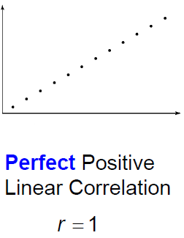
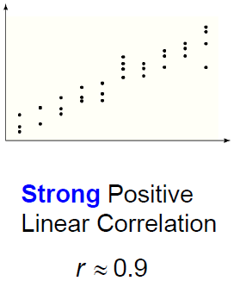
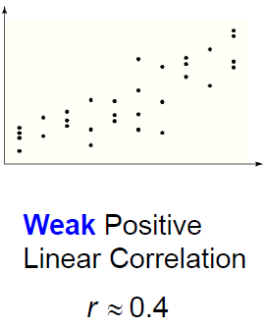
Positive Correlation

Slide 14
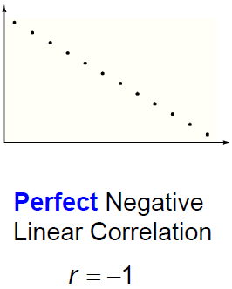
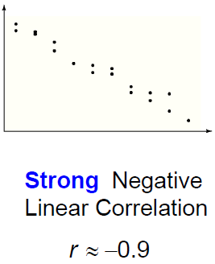
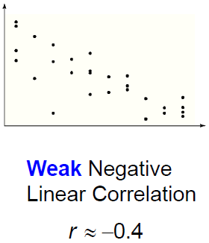
Negative Correlation

Slide 15
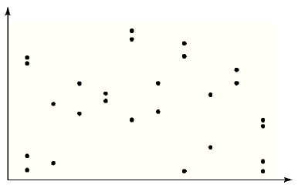
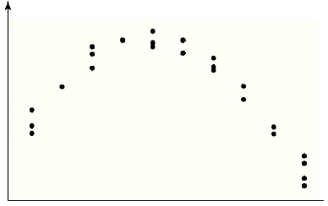
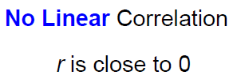
No Correlation:

Slide 16
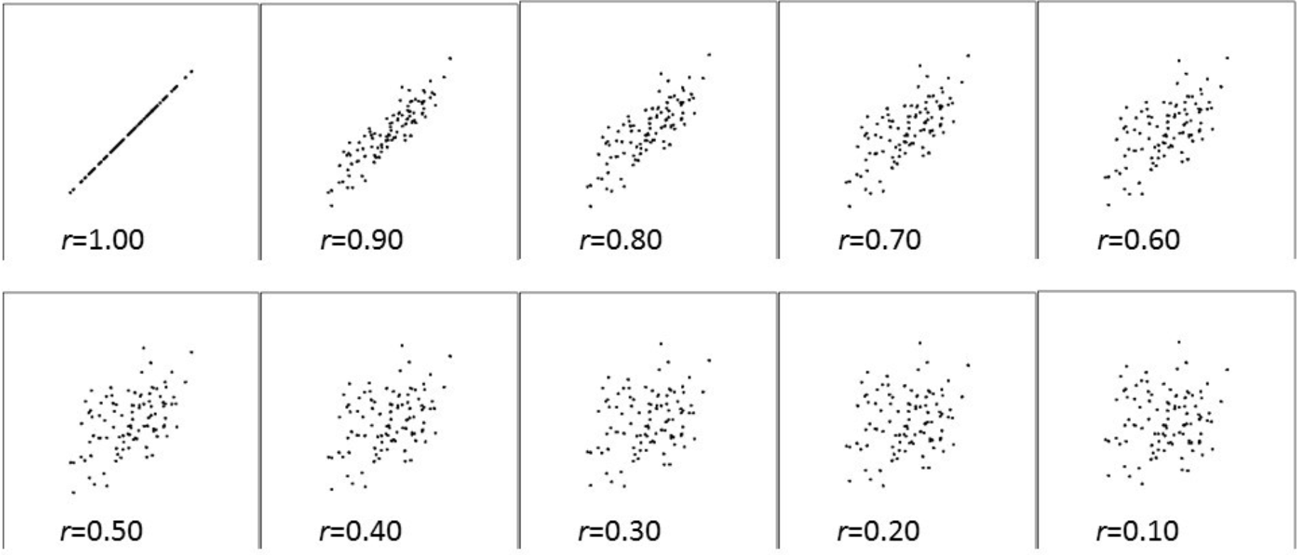

Slide 17
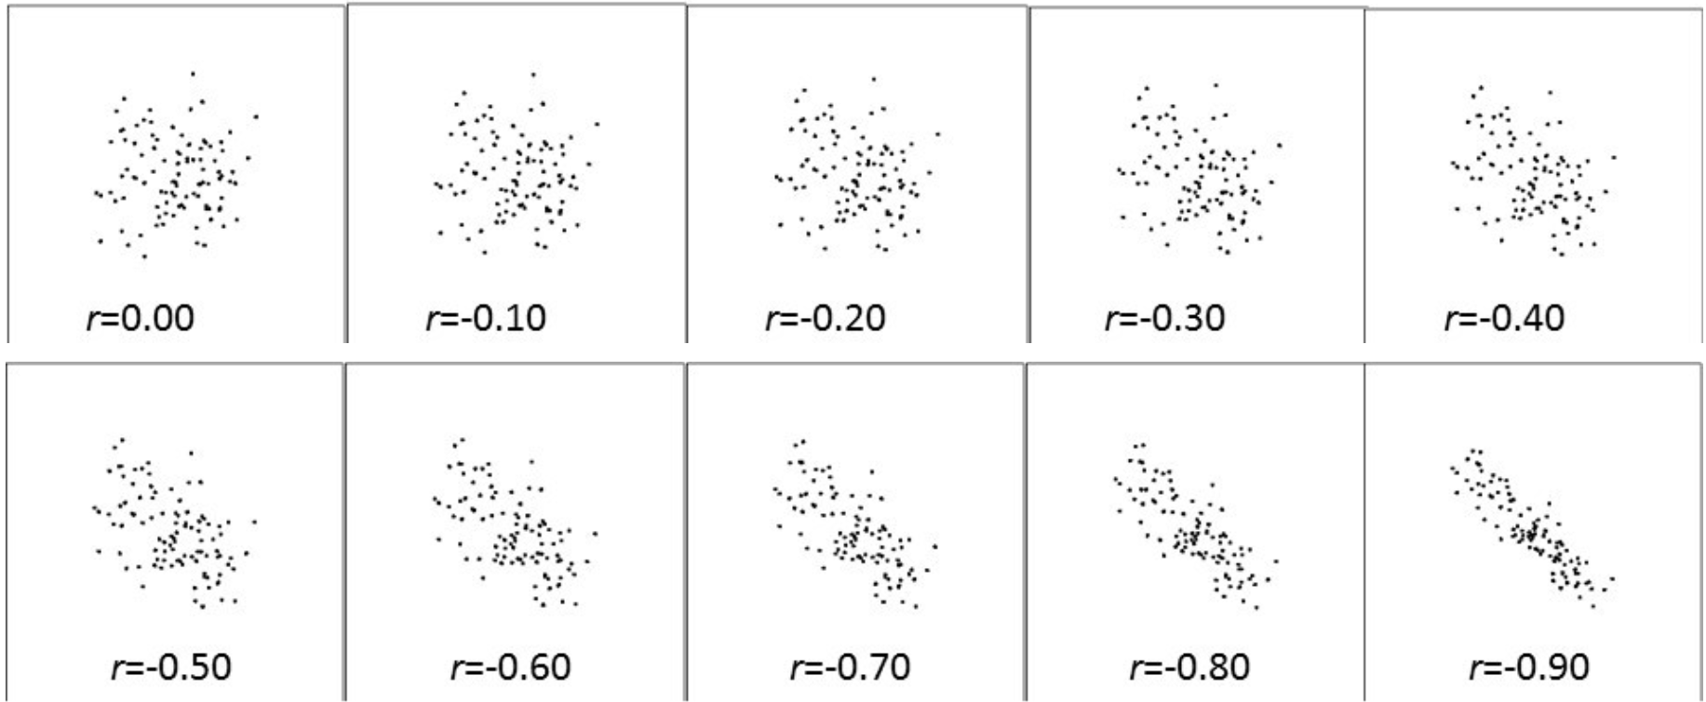
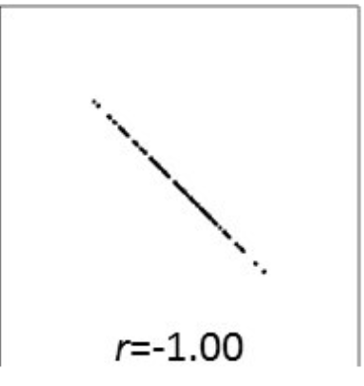

Slide 18
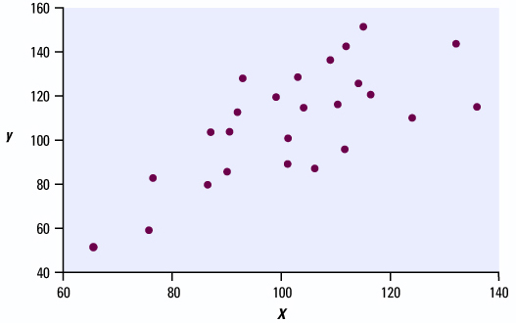
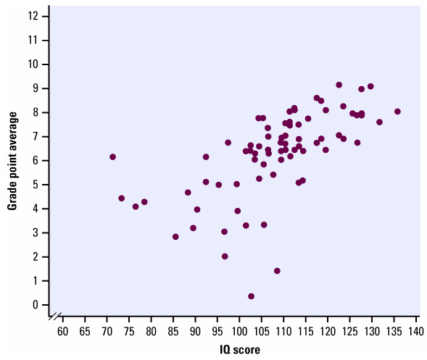
Ex: Describe each of the following scatter plots
Direction:
Positive Correlation
Direction:
Form:
Linear
Form:
Strength:
Moderate to weak
Strength:
Outliers
Outliers

Slide 19
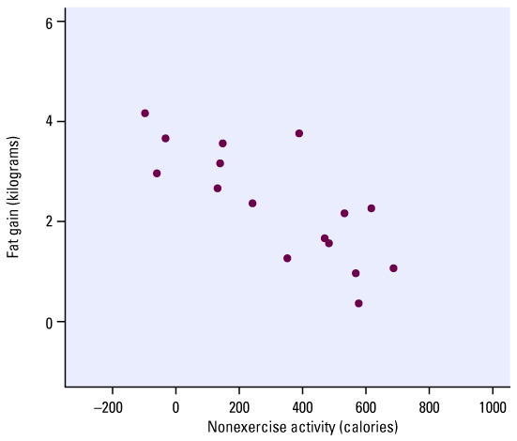
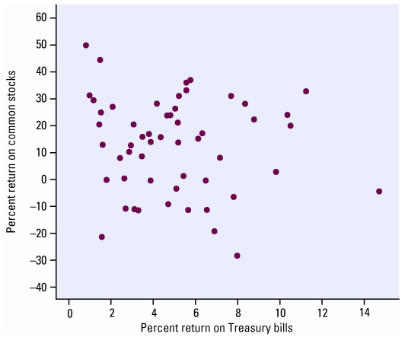
Direction:
Direction:
Form:
Form:
Strength:
Strength:
Outliers
Outliers

Slide 20
Properties of Correlation:
“Correlation” [r] measures the direction and strength of the linear relationship between two quantitative variables
Both variables must be Quantitative
Correlation does NOT have a unit of measurement [just a numerical value between -1 to 1]
Positive ‘r’ → Positive correlation (Both variables increase together)
Negative ‘r’ → Negative correlation (One decreases when the other increases)
A Strong Correlation of “1” DOES NOT indicate or imply Causation!!

Slide 21




Properties of Correlation
Correlation value ranges from -1 to 1 [can NOT be bigger than 1]
Correlations are Strongly affected by outliers
If ‘r’ is close to 1 → strong evidence of positive association between the two variables
If ‘r’ is close to -1 → strong evidence of negative association between the two variables
If ‘r’ is equal to zero → the relationship is not linear, but a strong relationship can still exist [curved relationship]
No Linear
Relationship

Slide 22

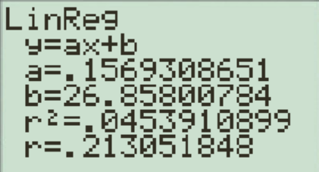
HOW TO FIND Correlation:
To find the correlation coefficient use your Ti 83!!
1. Make sure you turn your Diagnostic “ON”: Press “2nd” “0” [Catalog]
2. Scroll down to turn Diagnostic On an Press Enter
3. Enter data Points in L1 and L2
4. Press “STAT” “CALC” “4: Linreg(ax+b)

Slide 23
The correlation coefficient is purely a number , DOES NOT have units!! [ie: not a percentage, do not use the unit from either variables]
It is not affected by:
Interchanging the two variables (switching x-y)
Add the same number to all the values of one variable
Multiplying all the values of one variable by the same positive number
Correlation “r” is NOT resistant to outliers [Highly affected]
Outliers can easily affect correlation
Outliers are found by looking at scatterplot
“r” measures linear associations, not any associations in general
Not quadratic or exponential…

Slide 24
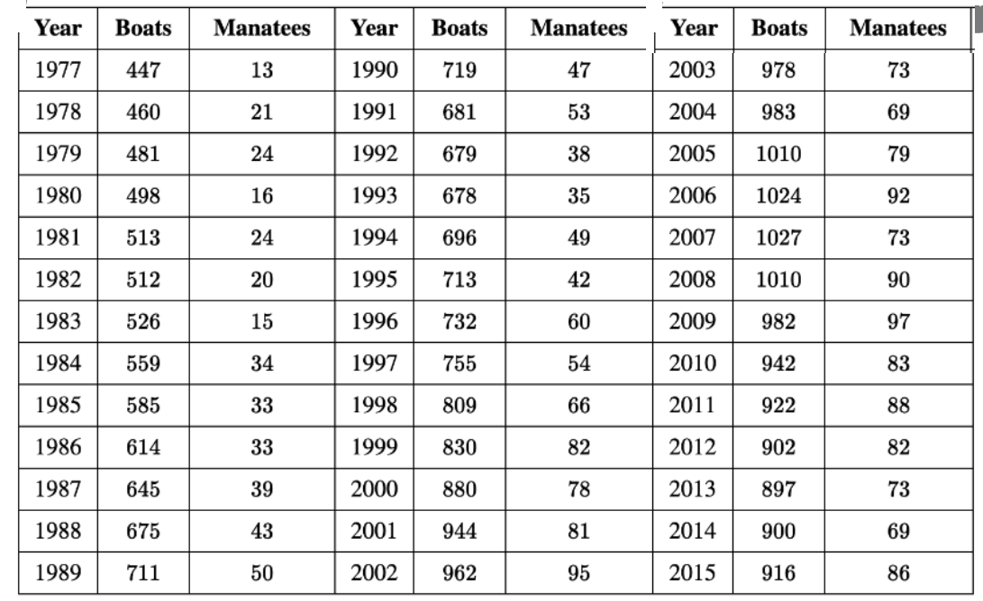
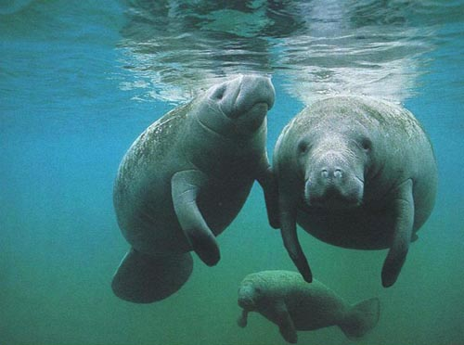
Ex: Manatees are large, gentle sea creatures that live along the Florida coast. Many manatees are killed or injured by powerboats. Here are data on power boat registrations (in thousands) and the number of manatees killed by boats in Florida in the years 1977 to 2015. i) state the explanatory and response variables ii) find the correlation between the number of powerboats and manatees killed. Ii) Is there a strong correlation between the 2 variables?
Number of Powerboats are given in 1000’s

Slide 25
When describing the Explanatory and Response variables , make sure to be precise with your definitions.
Explanatory variable: the number of registered powerboats in the 1000’s
Response variable: the number of manatees killed by powerboats in Florida from 1977 to 2015

Slide 26
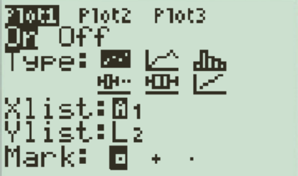
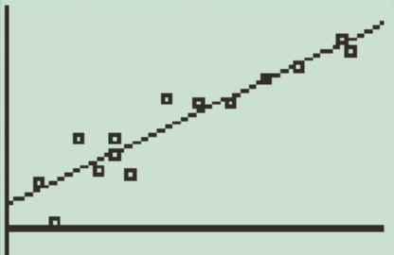
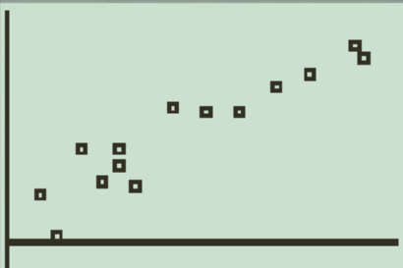
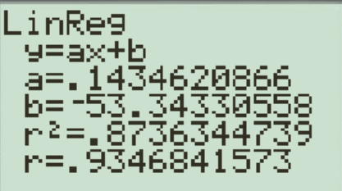
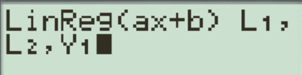
Make a scatterplot of these data. (Be sure to label the axes with variable names, not just x and y.) What does the scatterplot show about the relationship between these variables?
Number of Manatees Killed
Number of Powerboats (1000s
Our scatterplot shows a strong linear relationship between the two variables. The correlation between “Number of Powerboats (1000s)” and Manatees killed is 0.9346. This suggests that there is a strong association between the number of powerboats (1000’s) and number of manatees killed

Slide 27
Q: Which of the following is the correct interpretation of the slope in the scenario between the number of manatees killed and the number of powerboats in the Florida coast. [a=0.1434]
a) For every increase in one manatee, the expected increase in the number of powerboats in 0.14 thousand
b) For every increase in one thousand powerboats, the predicted increase in manatee deaths is 0.1434
c) For every increase in one thousand powerboats, there is expected increase of 0.1434 predicted manatee deaths
d) For every increase in one manatee death, there is expected increase of 0.1434 thousand predicted registered powerboats
e) For every increase in one thousand powerboat the model predicts there to be an increase of 0.1434 manatee deaths.

Slide 28
INTERPRETING the slope in context: For every increase in the “explanatory variable” of one “unit”, the “predicted response variable” is to increase by “ value of slope”

Slide 29

CSI –Statistics (Activity)
Mr.Cheng keeps a large jar full of cookies for use in his class. Over the past few days, a few cookies have been missing. He asks his colleagues whether if they have been taking his cookies, no one confesses to the crime. But the next day, Mr. C find a clear footprint near the cookie jar. At this point, Mr. C calls in Mr. Young’s statistic class to help identify the culprit.
Measure the height(cm) and footsize(cm) of each member in the classroom.
Record the data in a table and then graph a scatterplot of Height vs Footprint
Use the evidence from your graph to determine which
Math teacher has been stealing the cookies!!
Mr. Chang?(5’7”) Mr. Cheong?(5’8”) Mr. Depaco? (5’9”) Ms. Wu? (5’5”) Ms. Chiru? (5’6”) Mr Young (5’11”) Mr. Buchannon?(6’1)

Slide 30
180
175
170
Height (cm)
165
160
155
150
16
17
18
19
20
21
22
23
24
25
26
27
Footsize (cm)

Slide 31
Three data sets are collected, and the correlation coefficient is computed in each case. The variables are:
i) GPA in grade 8 vs GPA in grade 10
ii) GPA in grade 8 vs GPA in grade 12
iii) Length and weight of two by four wood beams
Match each scenario with the given correlation coefficients:
-0.49, 0.0, 0.33, 0.62, and 0.96
Explain your answers:

Slide 32
ex: The correlation between height and weight among men age 18-70 in North America is about 0.45. Indicate which of the following conclusions is correct?
a) Taller men tend to be heavier
This would be true, since we have a positive correlation
b) The correlation between weight and height for men age between 18 to 70 is about 0.45
True, this is the information given
c) Heavier men tend to be taller
True b/c this statement is implying a positive correlation between weight and height
d) If someone eats more and put on another 5lbs, he is likely to get somewhat taller
False, correlation is not causation! Response and Explanatory variable can NOT be used interchangeably

Slide 33
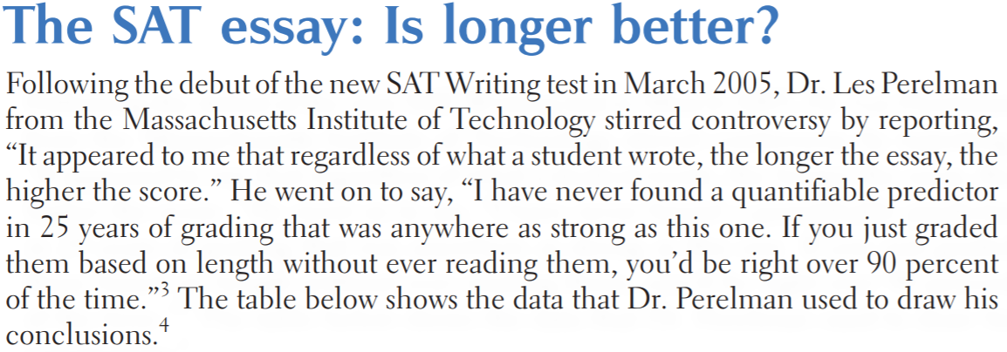
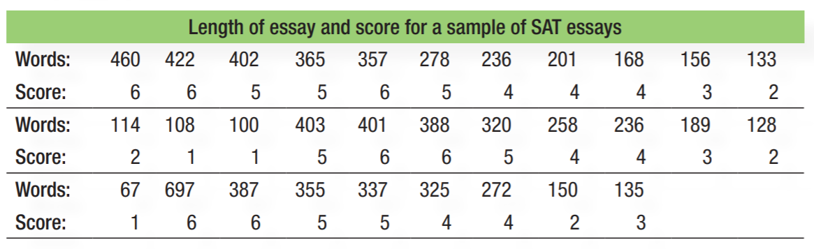
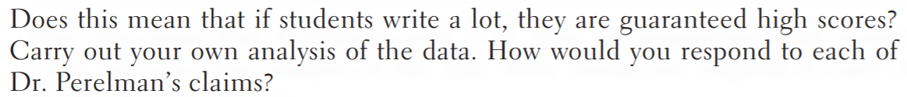

Slide 34
Explanatory Variable: The number of words in the SAT essay
Response Variable: The “predicted” SAT score from 1 to 6
SLOPE: 0.01037006
For every increase in one word in the essay, the predicted SAT score will increase by 0.01037
For every increase in 100 words in the essay, the “predicted” SAT score will increase by 1.037

Slide 35
Chapter Objectives
Explore bivariate data – study of two variables with an interest of how the change in one variable is related to the change in another
When one variable is changing, can we predict the changes in the other
Analyze patterns in scatterplots
Correlation vs Causation
Correlation – explores the relationship between two variables
Causation – One variable is the direct cause of another
Correlation is not the same as causation!!
You can have a strong correlation between two variables but not have causation – lurking variables

Slide 36
Homework:

